Slide 1
DIY ECG Using Analog Discovery And LabVIEW
Submitted in the partial fulfillment for the award of the degree of
BACHELOR OF ENGINEERING
IN
INTERNET OF THINGS
Submitted by:
SHINDE SMITA SHAHAJI
20BCS4643
Under the Supervision of:
Dr. Gaurav Soni
Department of AIT-CSE
DISCOVER . LEARN . EMPOWER

Slide 2


APEX INSTITUTE OF TECHNOLOGY CHANDIGARH UNIVERSITY
DIY ECG Using Analog Discovery and LabVIEW
Building an Analog Discovery and LabView-Based ECG Device

Slide 3
Outline
Introduction to Project
Problem Formulation
Problem Identification
Project Scope
Objectives of the work
Methodology used
Hardware Specification
Software Specification
Hardware Setup
Results
Conclusions
References

Slide 4

Problem Definition
A considerable proportion of the world’s population suffers from heart illnesses, which are responsible for 17.9 million fatalities annually. Unbelievably, research shows that as many as 50 of people with cardiac problems do not receive the appropriate diagnosis or treatment, underscoring inequalities in the accessibility and cost of healthcare. Traditional ECG devices can cost thousands of dollars, making them expensive for many people who require cardiac monitoring. The cost of an ECG can vary
This project holds great promise for creating accessible and affordable ECG monitoring solutions for both home and clinical use.

Slide 5

Introduction to Project
Electrocardiography (ECG) is vital for monitoring cardiac health and provides insights into the heart's electrical activity.
Conventional ECG machines can be expensive and not readily accessible to everyone, creating a need for a cost-effective solution.
The DIY ECG project's goal is to amplify, measure, and record the heart's natural electrical potential, which can provide valuable information about cardiac regulation and pathological conditions.
The circuitry is simplified by eliminating noise reduction components and achieving noise reduction through post-processing the data with LabVIEW

Slide 6
Project Scope
Developing a cost-effective, portable, and Real time ECG recording device suitable for home use.
Integrating LabVIEW for data acquisition and visualization.
Creating a circuit that captures and analyzes ECG signals.
Simplifying the circuitry by eliminating noise reduction components, accomplished by post-processing the data with LabVIEW.
Employing electronic components, WaveForms, and surface electrodes
Testing the homemade ECG after setting up the software and leads.
Evaluating the device's accuracy and usability.

Slide 7

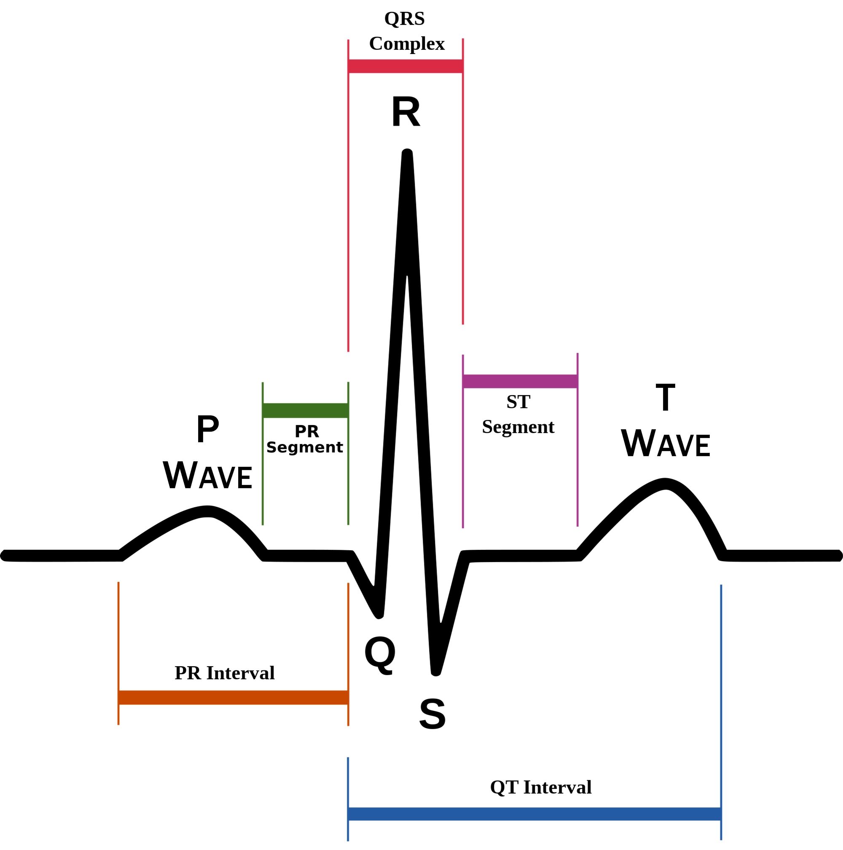
Problem Formulation
Traditional ECG machines are expensive, making them inaccessible for many people and healthcare providers.
Lack of affordable ECG options limits regular heart monitoring, delaying detection of potential cardiac issues.
Complexity and cost of existing devices prevent widespread use outside clinical settings, reducing opportunities for continuous monitoring and personalized healthcare.
This Photo by Unknown Author is licensed under CC BY-SA

Slide 8

Problem identification
Accuracy: Ensuring that the recorded ECG signals are precise and comparable to those obtained in clinical environments.
Portability: Creating a compact and lightweight design that can be easily carried around.
User-friendliness: Developing an interface that is simple enough for non-medical professionals to understand and operate.
Cost-effectiveness: Producing a product that is affordable yet delivers high-quality results.
Compatibility: Making sure the device works seamlessly with various operating systems and platforms.

Slide 9

Objectives of the Work
Develop a cost-effective ECG monitoring system using readily available components and software tools.
Design and implement hardware circuitry capable of accurately acquiring ECG signals.
Utilize LabVIEW for signal processing to enhance signal quality and extract meaningful data from ECG recordings.
Create a user-friendly interface for real-time ECG display and analysis.
Conduct testing with human subjects to ensure the system's accuracy, reliability, and user-friendliness.
Explore the feasibility of integrating wireless connectivity for remote monitoring and data transmission to smartphones or computers.

Slide 10
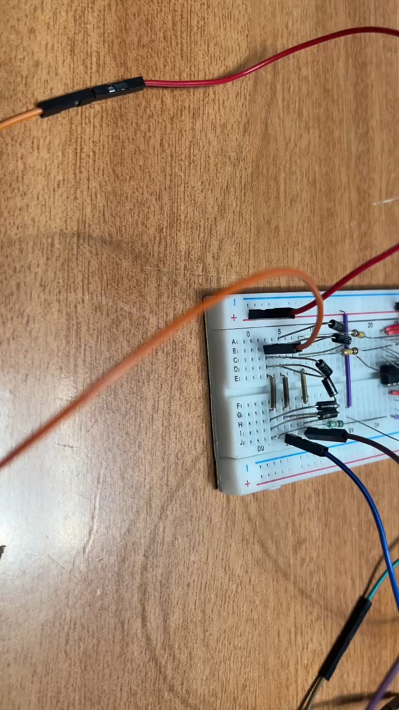
Project Video

Slide 11
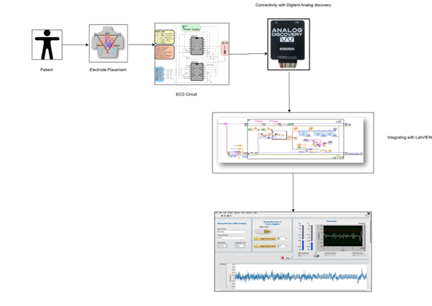
Methodology used

Slide 12

Hardware requirements
Analog Discovery USB Oscilloscope: Main tool for ECG signal acquisition and visualization.
OP482 Op Amp: Amplifies ECG signals to a measurable level for accurate data acquisition.
100 kΩ resistors: Used for impedance matching and signal conditioning.
10 kΩ resistors: Used for voltage division and signal conditioning.
1 uF electrolytic capacitor: Filters out DC offset and noise from ECG signals.

Slide 13

Hardware requirements
1 uF ceramic capacitor : Used for high-frequency noise filtering in signal conditioning.
Diodes: Provides protection against reverse polarity and voltage spikes.
Breadboard (Explorer Board): Platform for prototyping and assembling the hardware circuitry.
DIN ECG snap leads or alligator clips: Connects electrodes to the ECG circuitry for signal acquisition.
Surface electrodes: Placed on the skin to capture ECG signals accurately.

Slide 14
Software requirements
WaveForms: Software tool for controlling the Analog Discovery 2 USB Oscilloscope and acquiring ECG data.
LabVIEW: Programming environment for signal processing, user interface development, and data analysis in the project.

Slide 15
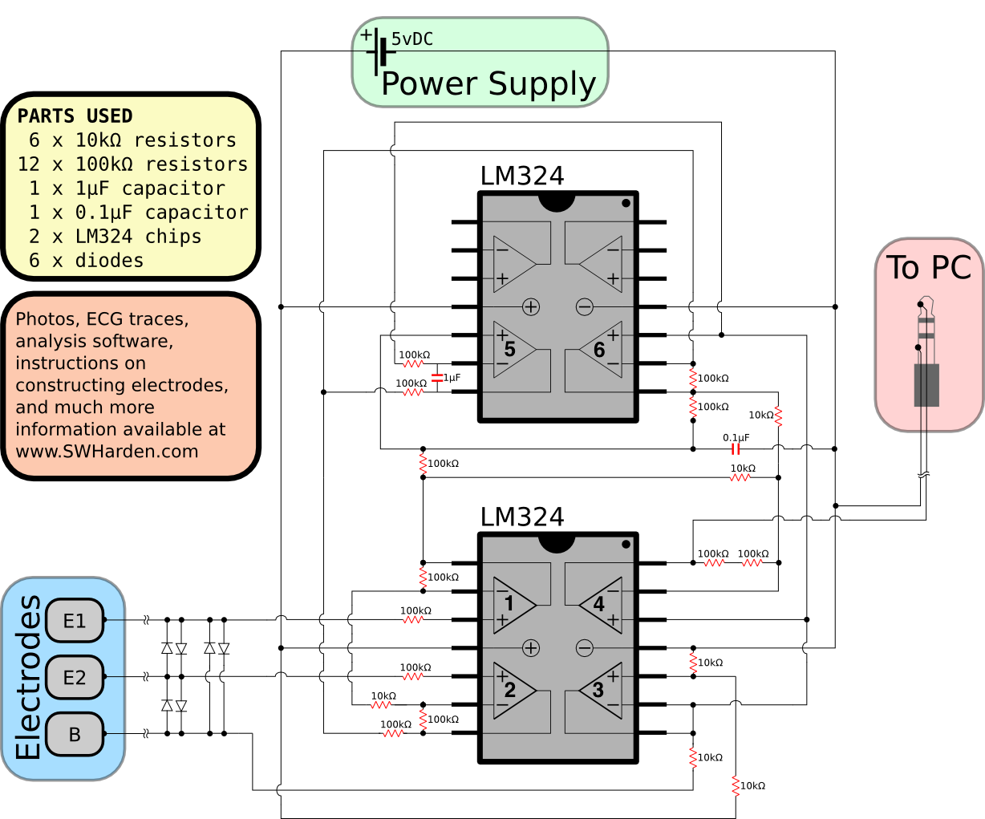
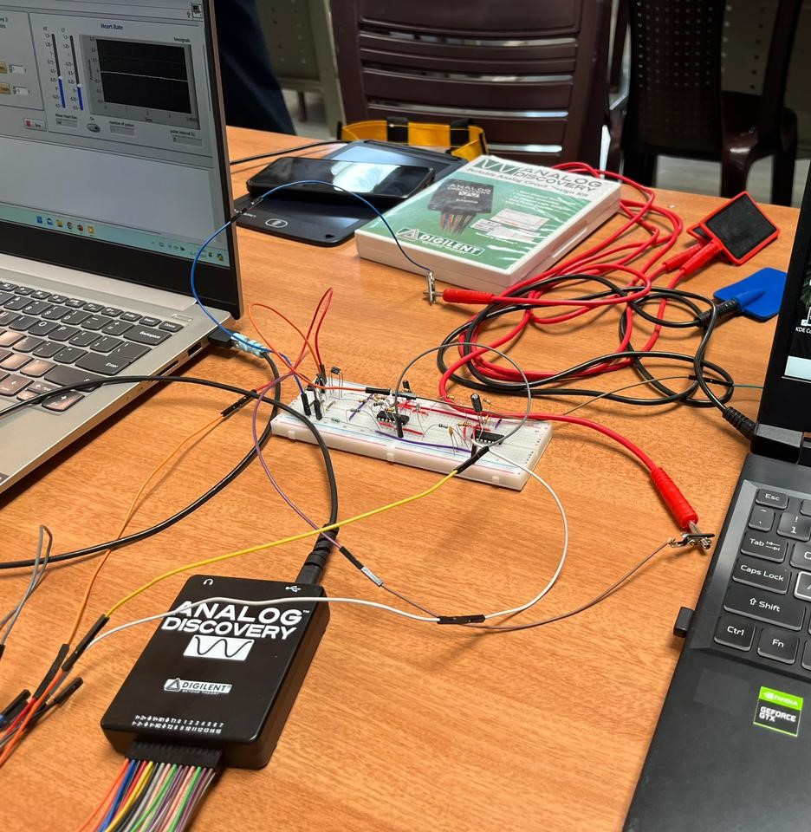
Hardware Setup

Slide 16
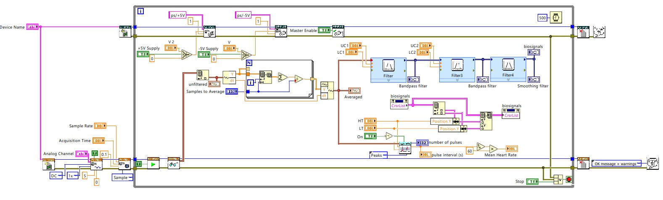
LabVIEW Circuit Design

Slide 17
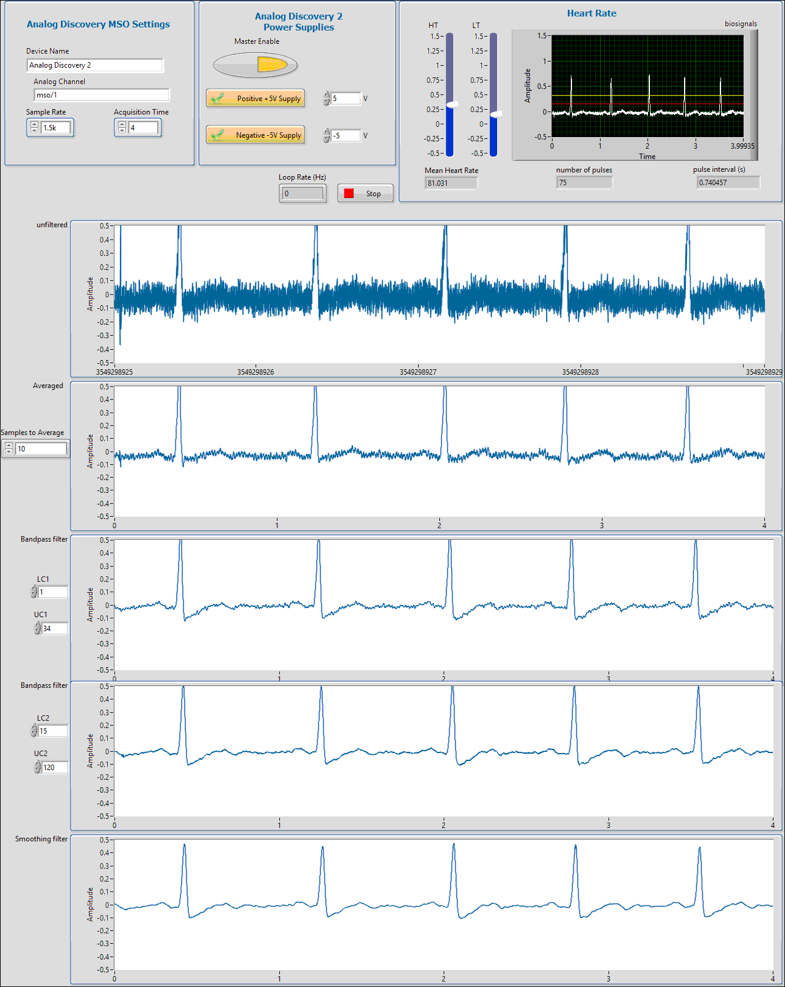
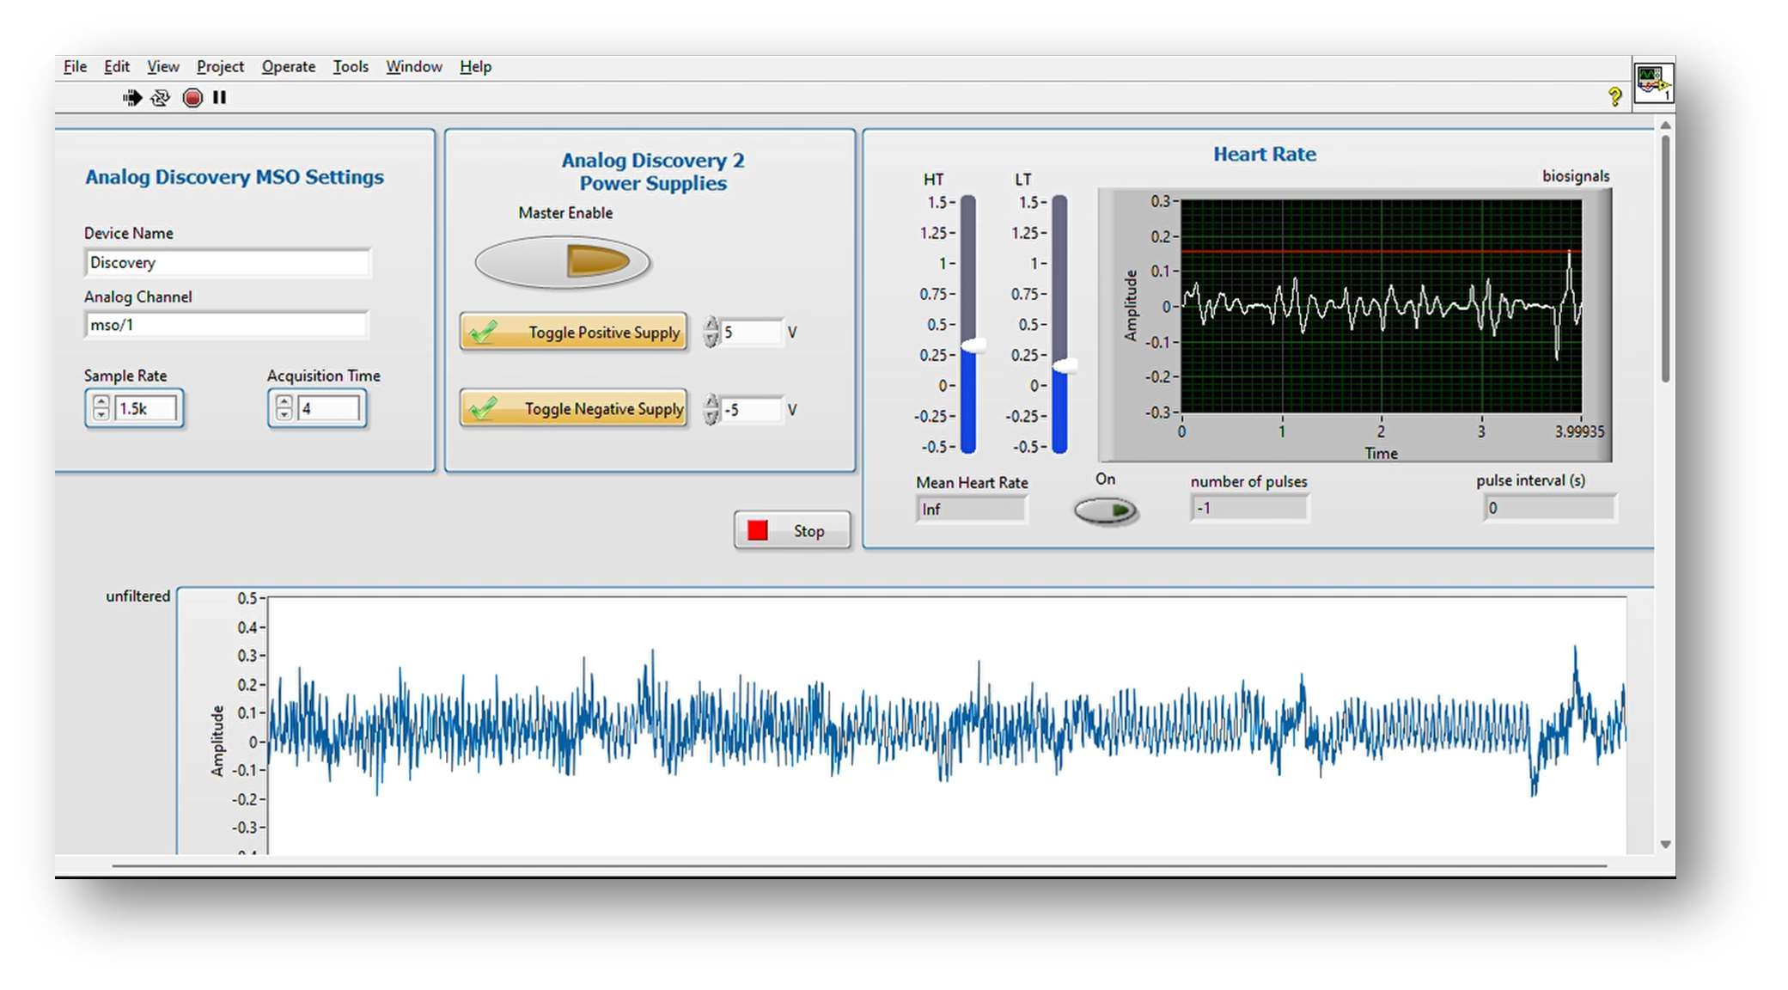
Results

Slide 18
Conclusions
Reliable and effective approach for noise reduction and baseline wander removal in ECG data
User-friendly platform using Diligent Analog Discovery Board and LabVIEW
Combination of techniques employed:
Wavelet denoising
Adaptive filtering
Linear regression for baseline wander removal
Effective removal of noise and baseline wander from ECG signals
Extraction of relevant features
Application of machine learning algorithms for improved accuracy

Slide 19
References
Serhani MA, T El Kassabi H, Ismail H, Nujum Navaz A. ECG Monitoring Systems: Review, Architecture, Processes, and Key Challenges. Sensors (Basel). 2020 Mar 24;20(6):1796. doi: 10.3390/s20061796. PMID: 32213969; PMCID: PMC7147367.
https://hackaday.com/2021/05/03/ecg-project-with-all-the-messy-safety-details/
A. M. Maghfiroh, S. D. Musvika, and V. Abdullayev, “Performance Comparison of ECG Bio-Amplifier Between Single and Bi-Polar Supply Using Spectrum Analysis Based on Fast Fourier Transform”, Indones.J.electronic.electromed.med.inf, vol. 4, no. 4, pp. 174-181, Nov. 2022.
Zhang Y, Gu A, Xiao Z, Xing Y, Yang C, Li J, Liu C. Wearable Fetal ECG Monitoring System from Abdominal Electrocardiography Recording. Biosensors (Basel). 2022 Jun 30;12(7):475. doi: 10.3390/bios12070475. PMID: 35884277; PMCID: PMC9313261.
https://www.mayoclinic.org/tests-procedures/ekg/about/pac-20384983
Bittencourt JA, et al. "Home cardiac monitoring: a systematic review." Journal of Medical Internet Research, vol. 19, no. 11, pp. e24428, November 2017.

Slide 20

THANK YOU!

